Slide 1

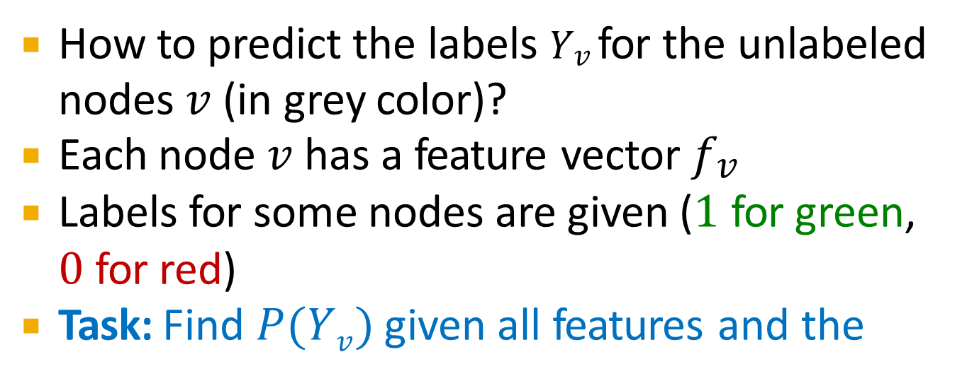
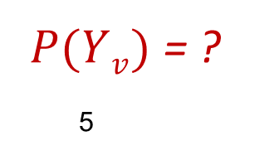
How to predict the labels 𝑌$v$ for the unlabeled nodes 𝑣 (in grey color)?
Each node 𝑣 has a feature vector 𝑓$v$
Labels for some nodes are given (1 for green,
0 for red)
Task: Find 𝑃(𝑌$v$) given all features and the
network
𝑃(𝑌$v$) = ?
5
7
3
9
4
1
8
6
2

Slide 2
We focus on semi-supervised node classification
Intuition is based on homophily: Similar nodes
are typically close together or directly connected
Three techniques we will introduce:
Relational classification
Iterative classification
Belief propagation

Slide 3
Relation Classification and Iterative Classification

Slide 4
Relational classifiers
Iterative classification
Loopy belief propagation

Slide 5
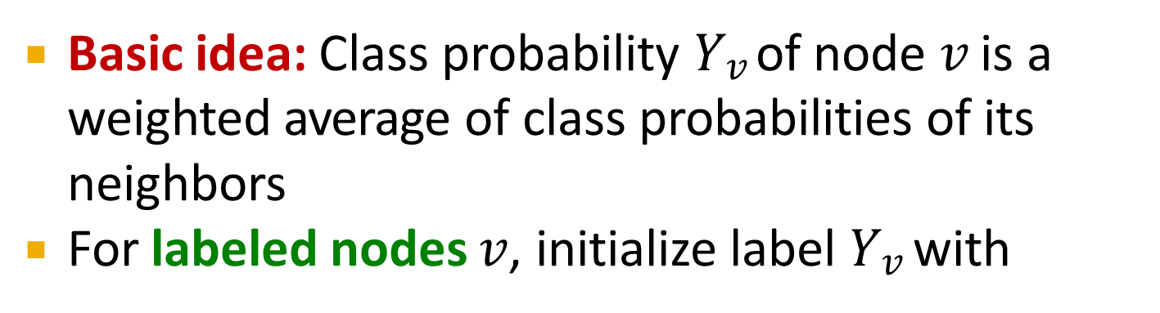
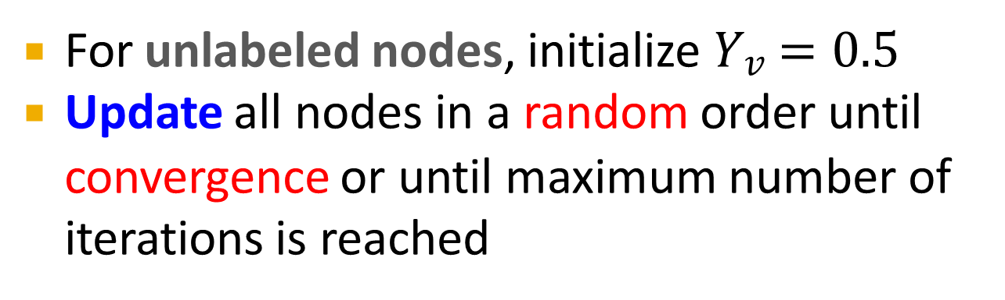
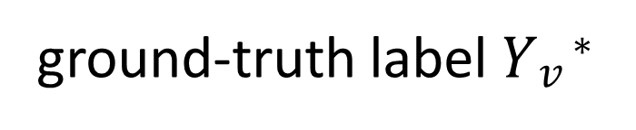
Basic idea: Class probability 𝑌$v$ of node 𝑣 is a weighted average of class probabilities of its neighbors
For labeled nodes 𝑣, initialize label 𝑌$v$ with
ground-truth label 𝑌$v$∗
For unlabeled nodes, initialize 𝑌$v$ = 0.5
Update all nodes in a random order until
convergence or until maximum number of iterations is reached

Slide 6
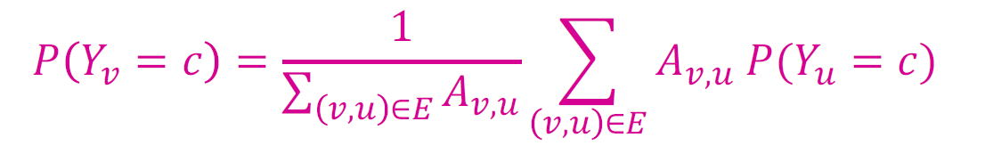
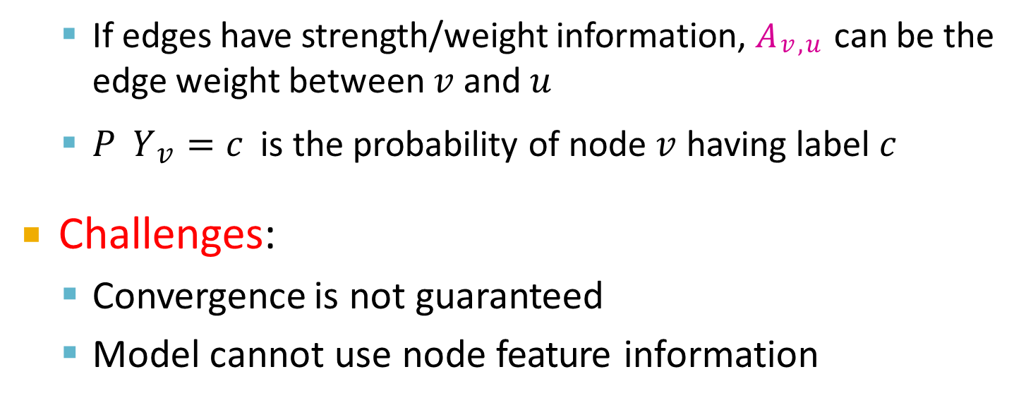
Update for each node 𝑣 and label 𝑐 (e.g. 0 or 1)
If edges have strength/weight information, 𝐴$v$,$u$ can be the edge weight between 𝑣 and 𝑢
𝑃 𝑌$v$ = 𝑐 is the probability of node 𝑣 having label 𝑐
Challenges:
Convergence is not guaranteed
Model cannot use node feature information

Slide 7

Initialization:
All labeled nodes with their labels
All unlabeled nodes 0.5 (belonging to class 1 with probability 0.5)
Let 𝑃_{Y1} = 𝑃(𝑌₁ = 1)
𝑃_{Y3} = 0.5
3
𝑃_{Y} = 1
7
𝑃 = 0.5
5
7
Y₅
4
𝑃_{Y4} = 0.5
9
𝑃 = 0.5
1
Y₉
𝑃_{Y} = 0
6
𝑃_{Y6} = 1
1
8
𝑃_{Y}= 0.5
2
𝑃_{Y2} = 0
8

Slide 8
Update for the 1st Iteration:
For node 3, 𝑁₃ = {1, 2, 4}
𝑃(𝑌₃) =
0 + 0 + 0.5 /3 = 0.17
𝑃(𝑌₇) = 1
7
𝑃(𝑌₅) = 0.5
5
3
9
𝑃(𝑌₉) = 0.5
4
𝑃(𝑌₄) = 0.5
1
8
𝑃(𝑌₈) = 0.5
6
𝑃(𝑌₆) = 1
𝑃(𝑌1) = 0
2
𝑃(𝑌₂) = 0

Slide 9
Update for the 1st Iteration:
For node 4, 𝑁₄ = {1, 3, 5, 6}
𝑃(𝑌₇) = 1
7
𝑃(𝑌₃) = 0.17
3
𝑃(𝑌 ) = 0.5
5
5
9
𝑃(𝑌₉) = 0.5
4
1
6
𝑃(𝑌₆) = 1
𝑃(𝑌₄)
= 0 + 0.17 + 0.5 + 1 /4
= 0.42
𝑃(𝑌 ) = 0
8
𝑃(𝑌₈) = 0.5
1
2
𝑃(𝑌₂) = 0
After Node 3 is updated

Slide 10
Update for the 1st Iteration:
For node 5, 𝑁₅ = {4, 6, 7, 8}
After nodes 3 and 4 are updated
𝑃 𝑌₅
= 1 + 0.5 + 1 + 0.42 /4
= 0.73
𝑃(𝑌₇) = 1
7
3
𝑃(𝑌 ) = 0.17
5
3
9
𝑃(𝑌₉) = 0.5
4
𝑃(𝑌₄) = 0.42
1
𝑃(𝑌 ) = 0
8
𝑃(𝑌₈) = 0.5
6
𝑃(𝑌₆) = 1
1
2
𝑃(𝑌₂) = 0

Slide 11
After Iteration 1 (a round of updates for all unlabeled nodes)
𝑃(𝑌₇) = 1
7
𝑃(𝑌₃) = 0.17
𝑃(𝑌 ) = 0.73
5
3
5
9
𝑃(𝑌₉) = 1
4
𝑃(𝑌₄) = 0.42
1
6
𝑃(𝑌₆) = 1
𝑃(𝑌 ) = 0
8
𝑃(𝑌₈) = 0.91
1
2
𝑃(𝑌₂) = 0

Slide 12
After Iteration 2
𝑃(𝑌₇) = 1
7
𝑃(𝑌₃) = 0.14
3
𝑃(𝑌 ) = 0.85
5
5
9
𝑃(𝑌₉) = 1
Converged
4
𝑃(𝑌₄) = 0.47
1
𝑃(𝑌 ) = 0
6
1
8
𝑃(𝑌₈) = 0.95
𝑃(𝑌₆) = 1
2
𝑃(𝑌₂) = 0

Slide 13
After Iteration 3
𝑃(𝑌₇) = 1
7
𝑃(𝑌₃) = 0.16
3
𝑃(𝑌 ) = 0.86
5
5
9
𝑃(𝑌₉) = 1
Converged
4
𝑃(𝑌₄) = 0.5
1
6
𝑃(𝑌₆) = 1
𝑃(𝑌 ) = 0
8
1
𝑃(𝑌₈) = 0.95
2
Converged
𝑃(𝑌₂) = 0

Slide 14
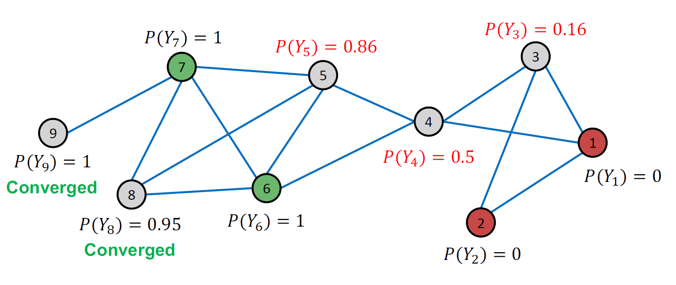
After Iteration 4

Slide 15

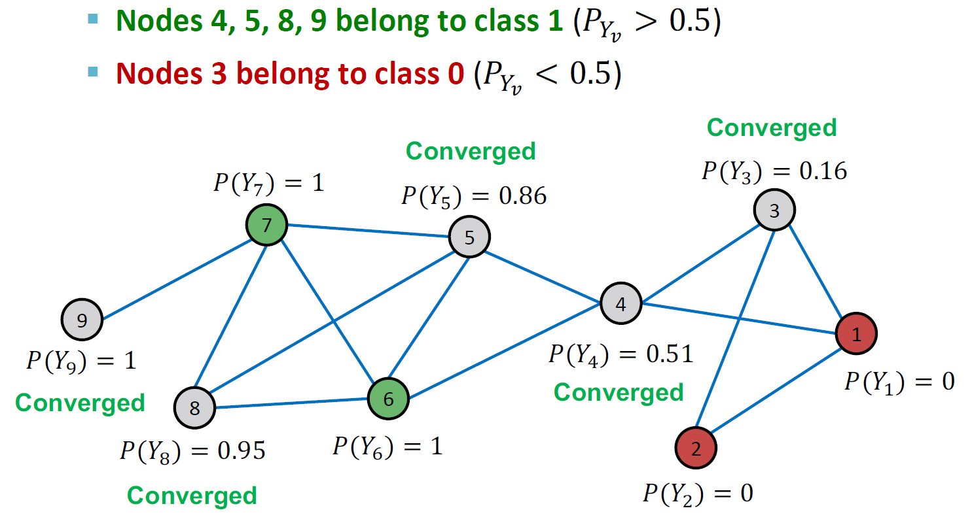
All scores stabilize after 4 iterations. We therefore predict:

Slide 16
Relational classifiers
Iterative classification
Loopy belief propagation

Slide 17
Relational classifiers do not use node attributes. How can one leverage them?
Main idea of iterative classification: Classify node 𝑣 based on its attributes 𝒇_{𝒗} as well as labels 𝒛_{𝒗} of neighbor set 𝑵_{𝒗}

Slide 18
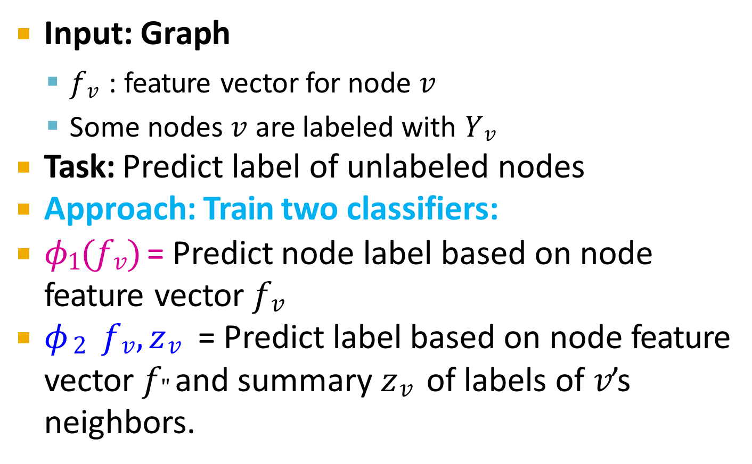
Input: Graph
𝑓$v$ : feature vector for node 𝑣
Some nodes 𝑣 are labeled with 𝑌$v$
Task: Predict label of unlabeled nodes
Approach: Train two classifiers:
𝜙₁(𝑓$v$) = Predict node label based on node feature vector 𝑓$v$
𝜙$2 fv, zv$ = Predict label based on node feature
vector 𝑓" and summary 𝑧$v$ of labels of 𝑣’s neighbors.

Slide 19
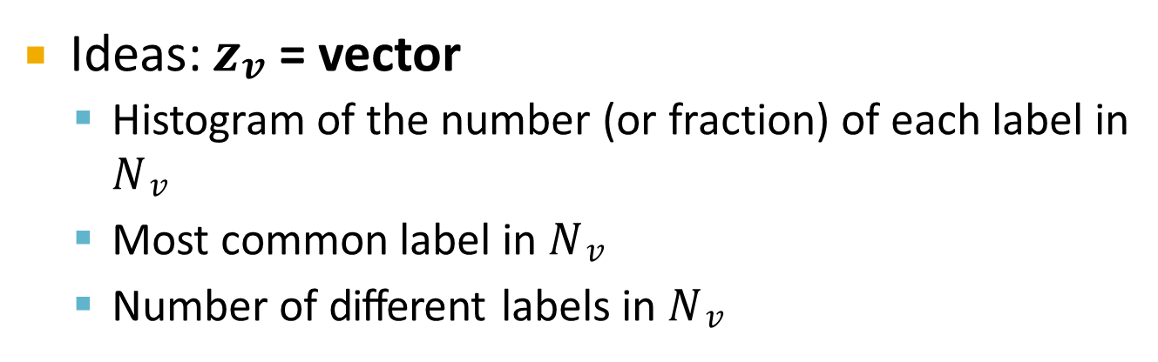
How do we compute the summary 𝒛_{𝒗} of labels of
𝒗’s neighbors 𝑵_{𝒗}?
Ideas: 𝒛_{𝒗} = vector
Histogram of the number (or fraction) of each label in
𝑁$v$
Most common label in 𝑁$v$
Number of different labels in 𝑁$v$
𝒇_{𝒗}, 𝒛_{𝒗}

Slide 20
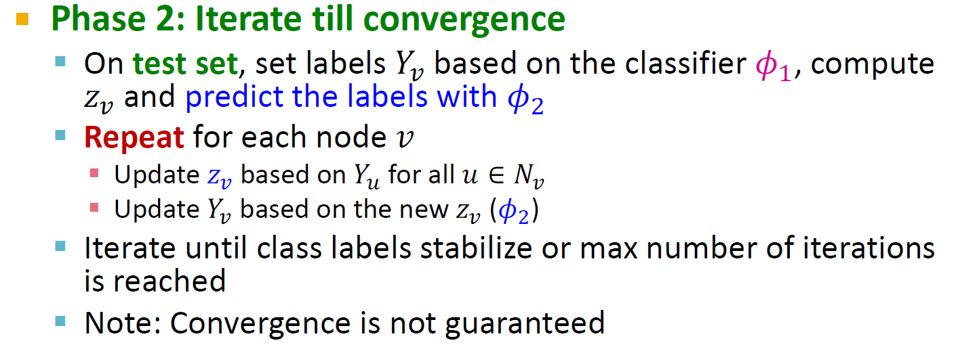
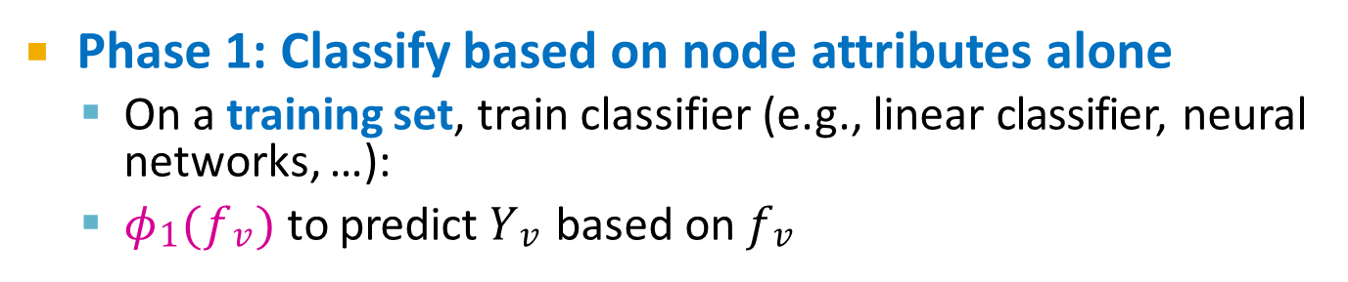
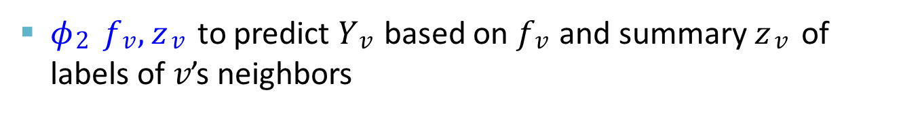
Phase 1: Classify based on node attributes alone
On a training set, train classifier (e.g., linear classifier, neural networks, …):
𝜙₁(𝑓$v$) to predict 𝑌$v$ based on 𝑓$v$
𝜙₂ 𝑓$v$, 𝑧$v$ to predict 𝑌$v$ based on 𝑓$v$ and summary 𝑧$v$ of labels of 𝑣’s neighbors

Slide 21
Input: Graph of web pages
Node: Web page
Edge: Hyper-link between web pages
Directed edge: a page points to another page
Node features: Webpage description
For simplicity, we only consider 2 binary features
Task: Predict the topic of the webpage

Slide 22
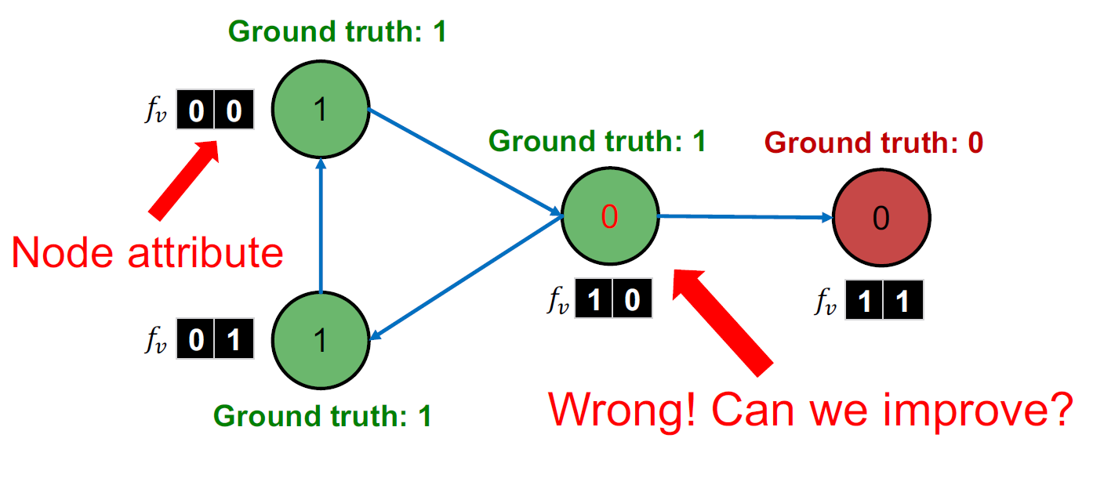
Baseline: train a classifier (e.g., linear classifier) to classify pages based on binary node attributes.

Slide 23
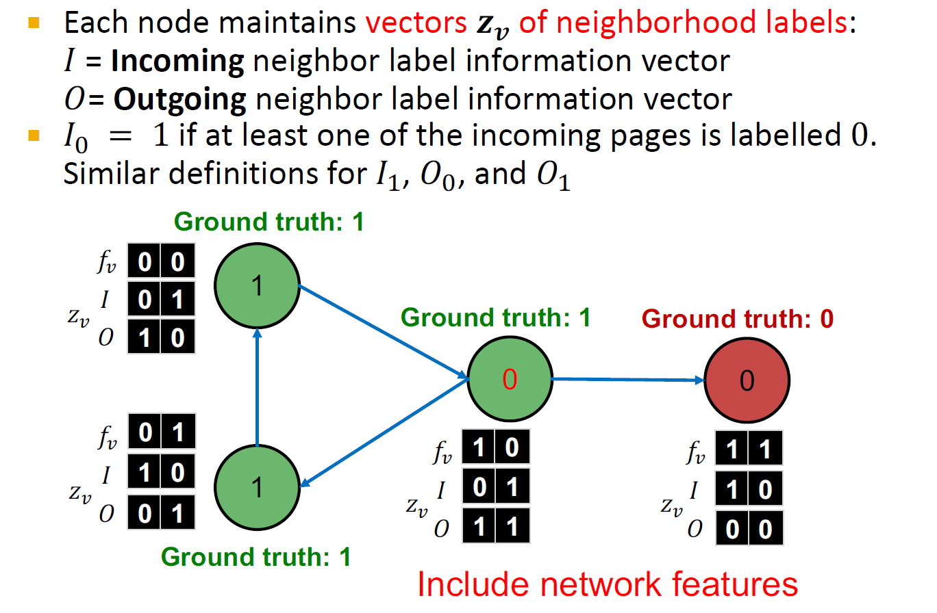

Slide 24
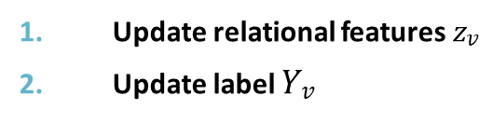
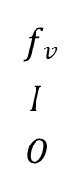
On a different training set, train two classifiers:
Node attribute vector only (green circles): 𝜙₁
Node attribute and link vectors (red circles): 𝜙₂
𝑓$v$
𝐼
𝑂
1 | 0
1 | 1
1 | 1
0 | 1
1 | 0
0 | 1
0
1
1.
2.
3.
Train classifier
Apply classifier to test set Iterate
Update relational features 𝑧$v$
Update label 𝑌$v$
1 | 0
0 | 0
1 | 0
0 | 0
1 | 0
0 | 0
1 | 0
0 | 1
1 | 0
0
0
1

Slide 25
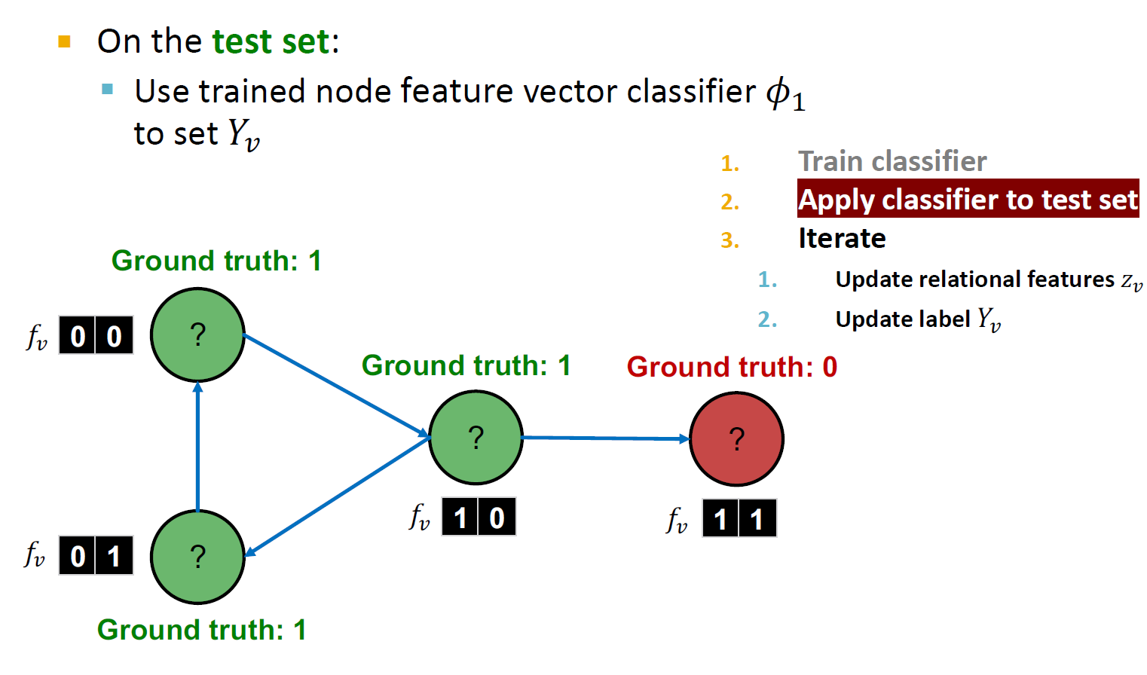

Slide 26
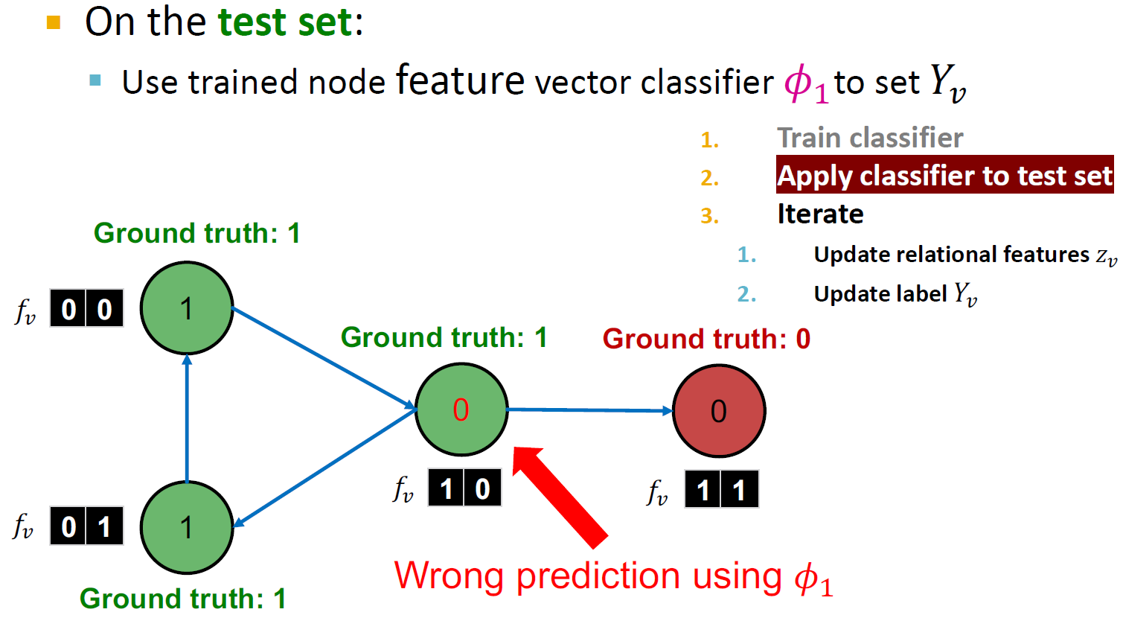

Slide 27
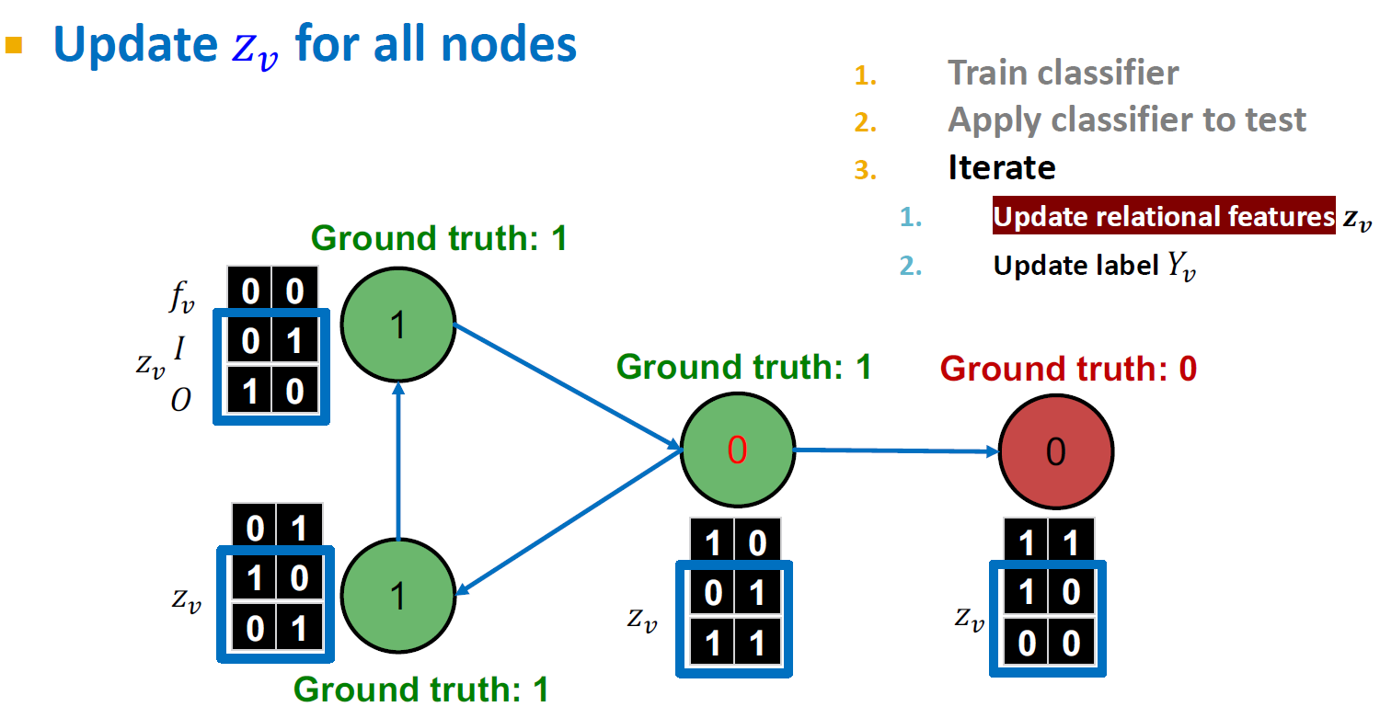

Slide 28
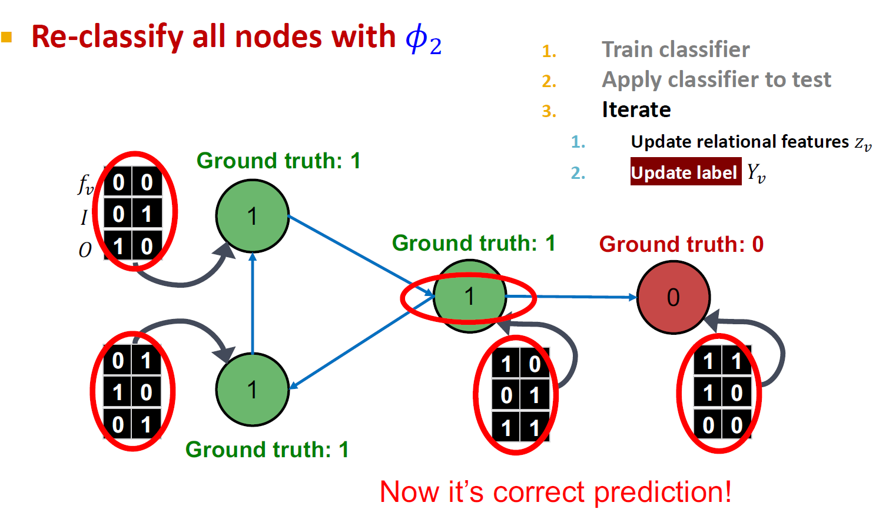

Slide 29
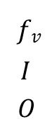
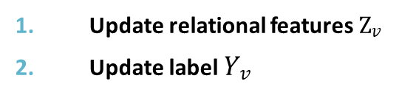
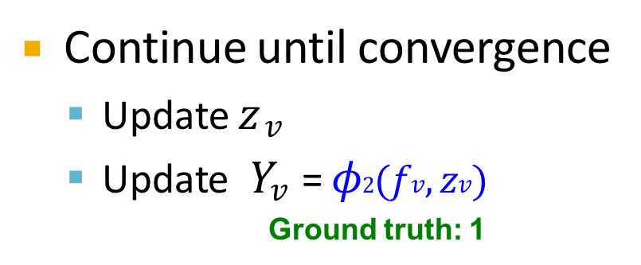
Continue until convergence
Update 𝑧$v$
Update 𝑌$v$= 𝜙$2$(𝑓$v$, 𝑧$v$)
Ground truth: 1
Train classifier
Apply classifier to test
3.
Iterate
Update relational features Z$v$
Update label 𝑌$v$
𝑓$v$
𝐼
𝑂
 | 0 | 0
 | 0 | 1
 | 0 | 1
1
Ground truth: 1
Ground truth: 0
1
0
Changed
1
Ground truth: 1
 | 0 | 1
 | 0 | 1
 | 0 | 1
1 | 0
0 | 1
1 | 1
1 | 1
0 | 1
0 | 0

Slide 30
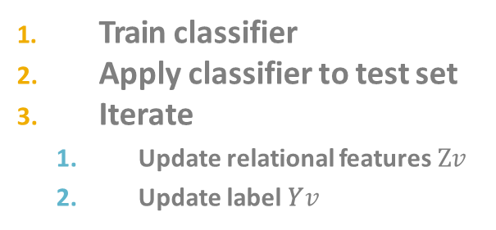
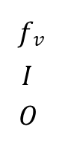
Stop iteration
After convergence or when maximum iterations are reached
Ground truth: 1
Train classifier
Apply classifier to test set
Iterate
Update relational features Z$v$
Update label 𝑌$v$
𝑓$v$
𝐼
𝑂
0 | 0
0 | 1
0 | 1
1
Ground truth: 1
Ground truth: 0
1
0
0 | 1
0 | 1
0 | 1
1 | 0
0 | 1
1 | 1
1 | 1
0 | 1
0 | 0
1
Ground truth: 1
Correct Now!

Slide 31

We talked about 2 approaches to collective classification
Relational classification
Iteratively update probabilities of node belonging to a label class based on its neighbors
Iterative classification
Improve over collective classification to handle attribute/feature information
Classify node 𝑖 based on its features as well as
labels of neighbors

Slide 32
Relational classifiers
Iterative classification
Loopy belief propagation

Slide 33
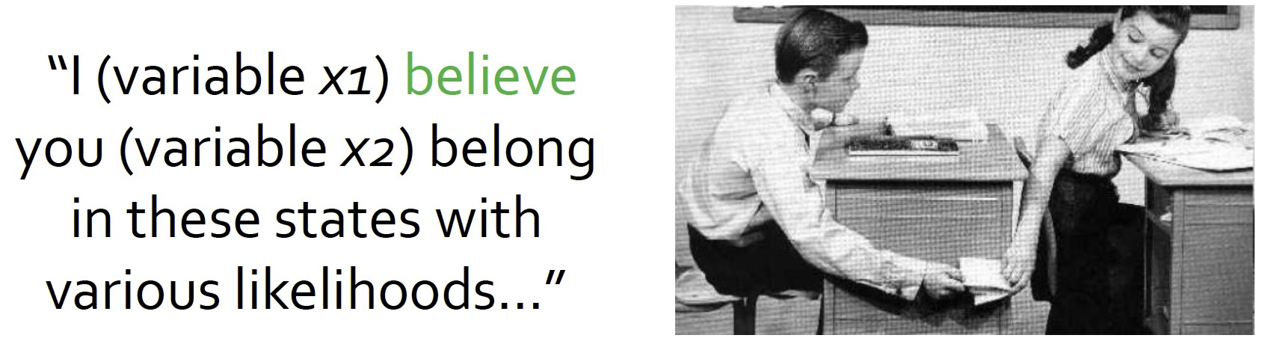
Belief Propagation is a dynamic programming approach to answering probability queries in a graph (e.g. probability of node 𝑣 belonging to class 1)
Iterative process in which neighbor nodes “talk” to each other, passing messages
“I (node v) believe you (node u) belong to class 1 with likelihood …”
When consensus is reached, calculate final belief

Slide 34
Task: Count the number of nodes in a graph*
Condition: Each node can only interact (pass message) with its neighbors
Example: path graph
6
5
4
3
2
1
* Potential issues when the graph contains cycles.
We’ll get back to it later!

Slide 35
Task: Count the number of nodes in a graph
Algorithm:
Define an ordering of nodes (that results in a path)
Edge directions are according to order of nodes
Edge direction defines the order of message passing
For node 𝑖 from 1 to 6
Compute the message from node 𝑖 to 𝑖 + 1 (number of nodes counted so far)
Pass the message from node 𝑖 to 𝑖 + 1
6 5 4 3 2 1

Slide 36
Task: Count the number of nodes in a graph
Condition: Each node can only interact (pass message) with its neighbors
Solution: Each node listens to the message from its neighbor, updates it, and passes it forward
𝑚: the message
𝑚 = 5 node before
𝑚 = 4 node before
𝑚 = 3 node before
𝑚 = 2 node before
𝑚 = 1 node before
6
5
4
3
2
1
Update belief:
5 + 1 = 6
Update belief: 𝑚 + 1 nodes before me

Slide 37

We can perform message passing not only on a path graph, but also on a tree-structured graph
Define order of message passing from leaves to root
1
2
3
4
5
7
6

Slide 38
Update beliefs in tree structure
1
2
3
Update belief:
1 + 1 + 1 = 3
4
5
𝑚 = 1 descendant
𝑚 = 1 descendant
7
6

Slide 39
Update beliefs in tree structure
Update belief:
1 + 5 + 1 = 7
1
𝑚 = 5 descendants
𝑚 = 1 descendant
2
3
4
5
7
6

Slide 40

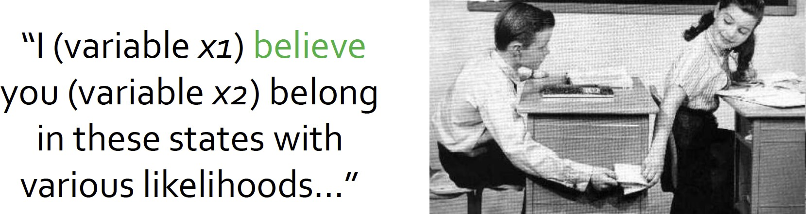
What message will 𝑖 send to 𝑗?
It depends on what 𝑖 hears from its neighbors
Each neighbor passes a
message to 𝑖 its beliefs of the state of 𝑖
𝑗
𝑘
𝑖
𝑢
𝑣
I (node 𝑖) believe that you (node 𝑗) belong to class 𝑌_{j} with probability
…

Slide 41

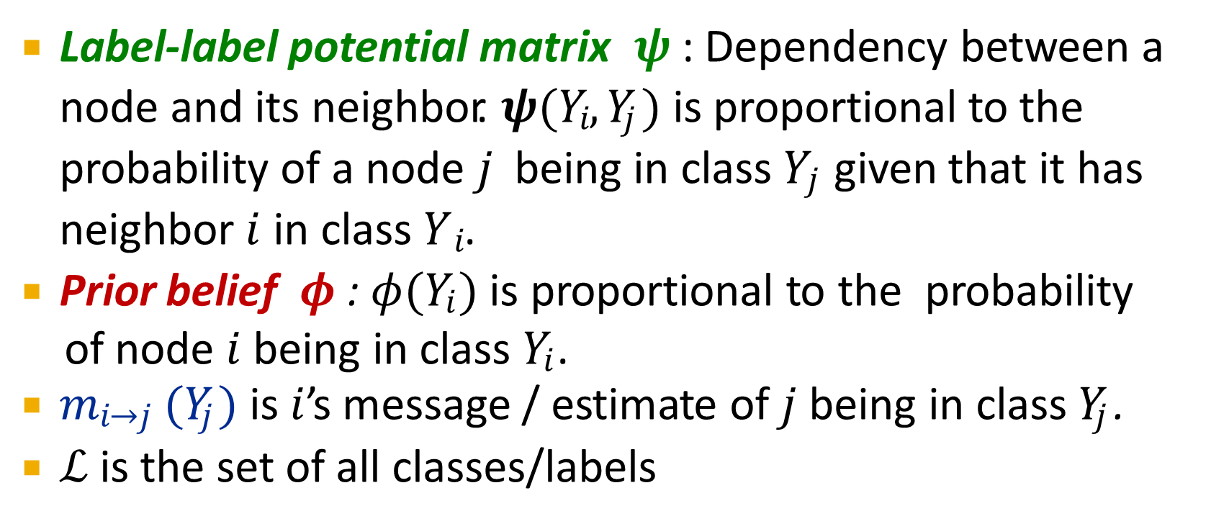
Label-label potential matrix 𝝍 : Dependency between a node and its neighbor. 𝝍(𝑌$i$, 𝑌$j$) is proportional to the probability of a node 𝑗 being in class 𝑌$j$ given that it has neighbor 𝑖 in class 𝑌 $i$.
Prior belief 𝝓 : 𝜙(𝑌$i$ ) is proportional to the probability
of node 𝑖 being in class 𝑌$i$ .
𝑚$i$→$j$(𝑌$j$ ) is 𝑖’s message / estimate of 𝑗 being in class 𝑌$j$ .
ℒ is the set of all classes/labels

Slide 42
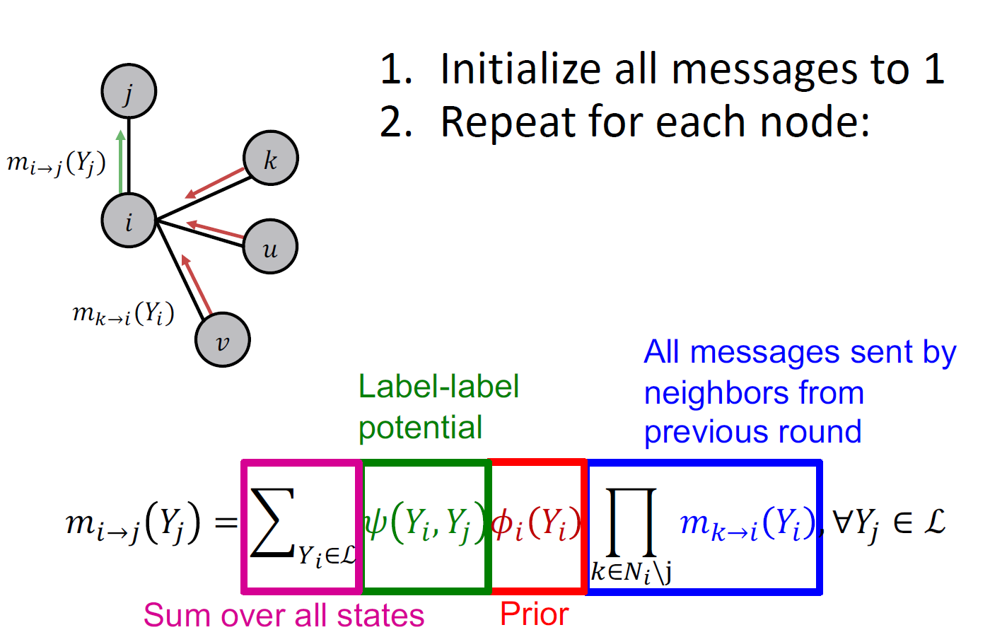

Slide 43
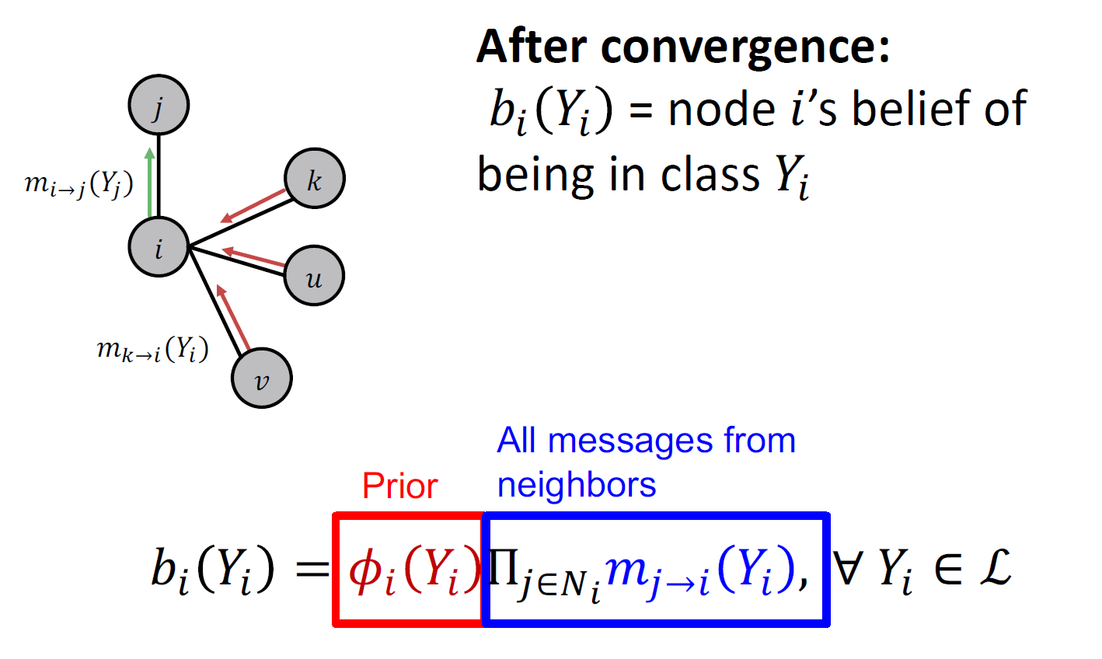

Slide 44
Now we consider a graph with cycles
There is no longer an ordering of nodes
We apply the same algorithm as in previous slides:
Start from arbitrary nodes
Follow the edges to update the neighboring nodes

Slide 45


What if our graph has cycles?
𝑗
Messages from different subgraphs are
no longer independent!
But we can still run BP, but it will pass messages in loops.
𝑖
𝑘
𝑢
𝑣

Slide 46
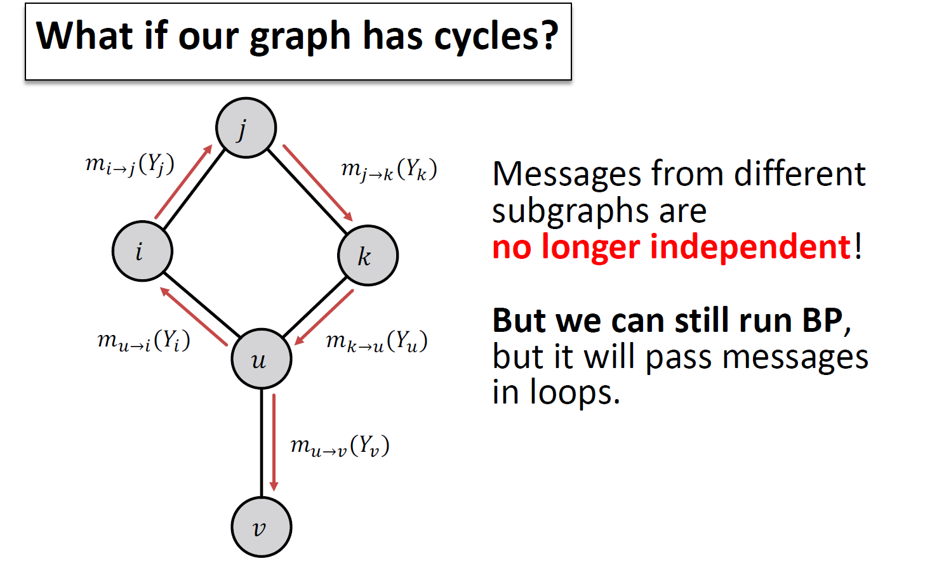

Slide 47

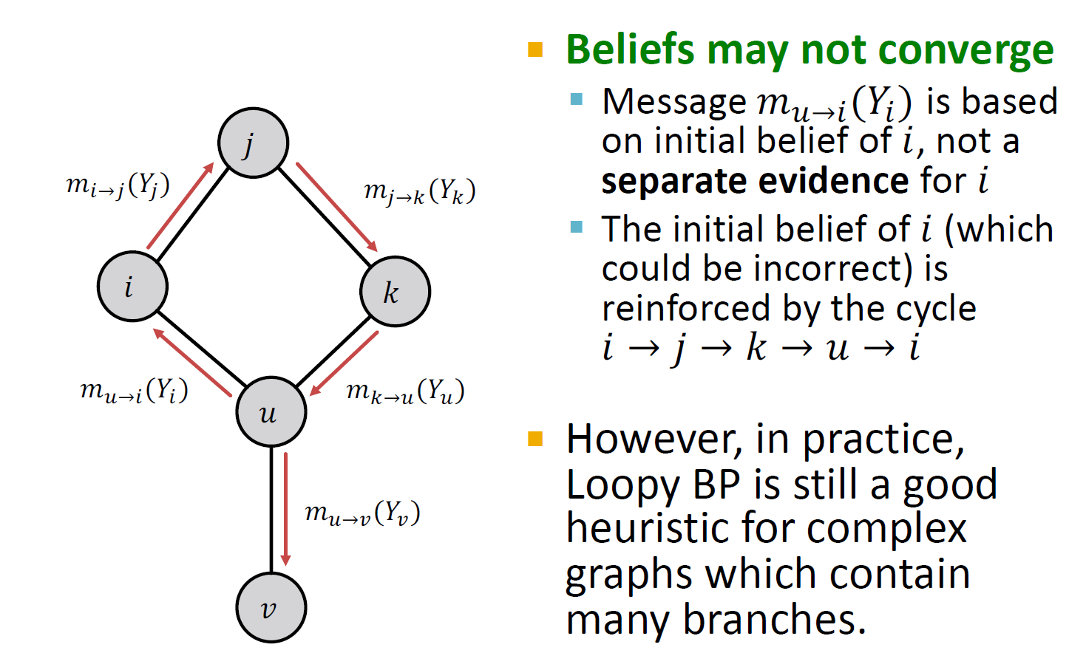

Slide 48
T | 4
F | 1
T
F
2
1
Messages loop around and around: 2, 4, 8, 16, 32, ... More and more convinced that these variables are T!
T | 2
F | 1
BP incorrectly treats this message as separate evidence that the variable is T (true).
Multiplies these two messages as if they were independent.
But they don’t actually come from
independent parts of the graph.
One influenced the other (via a cycle).
T | 4
F | 1
T 2
F 1
T | 2
F | 1
T | 2
F | 1
This is an extreme example. Often in practice, the cyclic influences are weak. (As cycles are long or include at least one weak correlation.)

Slide 49
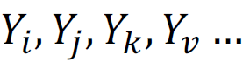
Advantages:
Easy to program & parallelize
General: can apply to any graph model with any form of potentials
Potential can be higher order: e.g. 𝝍( …)
Challenges:
Convergence is not guaranteed (when to stop), especially if many closed loops
Potential functions (parameters)
Require training to estimate

Slide 50
We learned how to leverage correlation in graphs to make prediction on nodes
Key techniques:
Relational classification
Iterative classification
Loopy belief propagation

